Slide 1
Service Governance Board
Terms of Reference
Version 2.0, February 2013

Slide 2
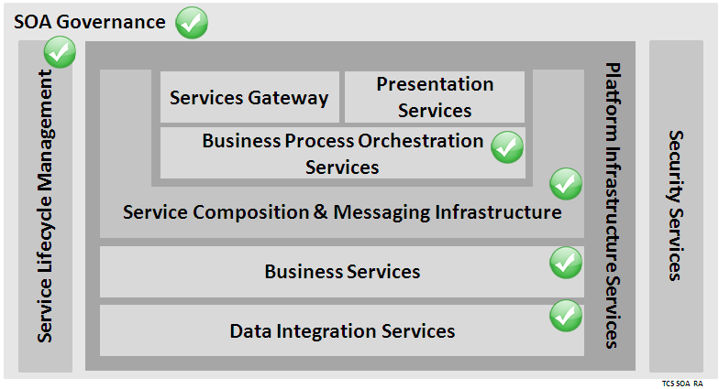
Scope of Service Governance Board (SGB) Service Governance Board has been formed to define , deploy and apply processes, methodologies, tools and technologies that will govern the production of enterprise services and maximize their reuse
Background
Business Areas
Retail
Commercial
Wholesale
Insurance
Enterprise services are generated by multiple platform teams within LBG using multiple technologies. Over the course of 2012-2013, there are many significant programmes in LBG that will use the enterprise services to deliver their objectives. As the number and types of consumers of these services expands, the quality of these services and their ability to absorb changes will become critical. SGB is the organization unit that will proactively guide the service producers and manage the enterprise services from inception to retirement through the use of standards , policies and procedures .
Group Operations
Wealth & International
BU
MULTI-CHANNEL
PAYMENTS
MORTGAGES
LP&i
Business Process Technologies
SGB Scope
Long-term – Expand to include Application Services, & Infrastructure Services
Short-term – Expand to include Process Services & Data Integration Services
Immediate Term – Business Services & Utility Services in E2E Simplification, FATCA. BAU, Galaxy
SGB Charter
Principles & Guidelines
Standards, Policies & Procedures
Service & Model Designs
LBG Enterprise Services Stakeholder Interactions
Tools
SGB Outcomes
External Parties
Clearly communicated Standards & Guidelines for service identification, design, development and implementation
Service Design Review s that ensure robust and reusable services
Introduction of Tools & technologies to support services creation and the practices laid out by SGB
Backend
Systems
CBS
ALS
OCIS
Others
Experian
Notes:
SGB Charter will be detailed further as the ToR expands

Slide 3
SGB Operating Model A brief overview
Operating Model
Activities Performed
Service Design reviews
Planning & Design initiation approval for identified services
Proposals and Review of proposed patterns, principles & policies
SME viewpoints for pressing technical design issues
Waivers for design approach/patterns used
Service Analysis & Design Tool demos
Knowledge sharing with Projects & SME community on SOA, LCSM, DP, MB
SOA Successes & Retrospectives with projects
Advice & Guidance to Projects
Frequency of Meetings
Scheduled Weekly for Reviews with Adhoc meetings for overflows from scheduled meetings
Adhoc meetings for waivers and urgent issues
Quarterly Knowledge sharing sessions
Monthly Retrospectives
Collaboration Platforms
Sharepoint for documents
NetMeetings & Discussion Boards for interaction

Slide 4
SGB Operating Model (continued..) A brief overview
Operating Model
Prerequisites
Design review - Scope includes all exposed on ESB irrespective of Service Model
Documents – Architecture Overview, Architecture Description Service Detailed Design, (if applicable) Data Dictionary, Candidate Host APIs for the service being reviewed, Other services in the overall solution
Schedule – Request for review & documents available 1 week before schedule date
Participants
Planning & Design initiation approval for identified services
Concept Note giving service description, capabilities/responsibilities, outline of data requirements, business justification
Service Analysis Document
List of participants is same as above except that Project Manager/DSM is mandatory for the transition to Planned state
Patterns/Policies/Other Design Enablers review & waivers for design approach/patterns used
Reference Documents made available 3 days ahead of meeting
Other critical or technical design issues
Reference Documents (if available) or a detailed mail describing the issue made available a few hours ahead of meeting
Advise & Guidance to Projects
Reference Documents (if available) or a detailed mail describing the issue made available 2-3 days ahead of meeting
MANDATORY
Approvers – Minimum of 3 approvers
Design Lead & Team - Minimum of 1 member
Associated project SME
Consumer representative
MANDATORY
Associated Solution Architect
LCSM Model Administrator
Systinet Administrator
DESIRABLE*
SD Representative
Project manager/DSM
* {Where the services have extensive dependency on infrastructure capability or special features, SD is a critical participant. The Chair, Design team or Consumer may request SGB for their availability}

Slide 5
SGB Operating Model (continued..) A brief overview
Operating Model
Procedure
Patterns/Policies/Other Design Enablers review or Other critical or technical design issue or Waivers
Summary of the discussion and conclusions are circulated
Update Architecture Decisions Log (if applicable)
Retrospectives or Advise & Guidance to projects
Looking back on the services dealt with during SGB along with the Consumer teams, Platform teams & Project teams
Note summarising Lessons learnt & Best practices from the project is published & circulated
Planning & Design initiation approval for identified services
Study team, SME & LCSM team clarifies for comments raised by members
Chair summarises if any further discussion needed/approval/rejection
Design review
Pre-configured Task-reminder alerts 2 days prior to SGB prompting Agenda and review items
Each session covers solution review of 2 services and requirements overview of next weeks services
Solution Design team provides a quick summary of the design
Chair shares comments against the self-assessment done by Design Team on the Basic Review Checklist
Design team clarifies for comments on the checklist responses & the other comments raised by members
Chair summarises if any further discussion needed/approval/rejection
Minutes of Meeting of session (Design decisions (if any) – from chair, Issues/Comments discussed – from Design team, Action Items – from Design team & chair) and RAID updates are published

Slide 6
SGB Operating Model (continued..) A brief overview
Operating Model
Approvals
Service Design Reviews / Service Planning
Approvals are subject to closure of action items raised on the Service stakeholders during the SGB session
Stakeholders share their concerns or acceptance in the session and over mail with the SGB chair
Where the stakeholders are not present in the SGB session, they can take 48 hours to raise their issues/concerns or provide their acceptance. Post 48 hours, the Design team will be permitted to assume acceptance provided all other action items are closed
Metrics
Number of services reviewed per month
Number of services approved and services rejected per month
Number of approved services that faced design issues (in DBT, SIT or concerns from Consumer) after SGB approval
Registering for SGB
Groups that adopt the SGB for Services Review will register with the chair and go through this Terms of Reference before coming on board

Slide 7
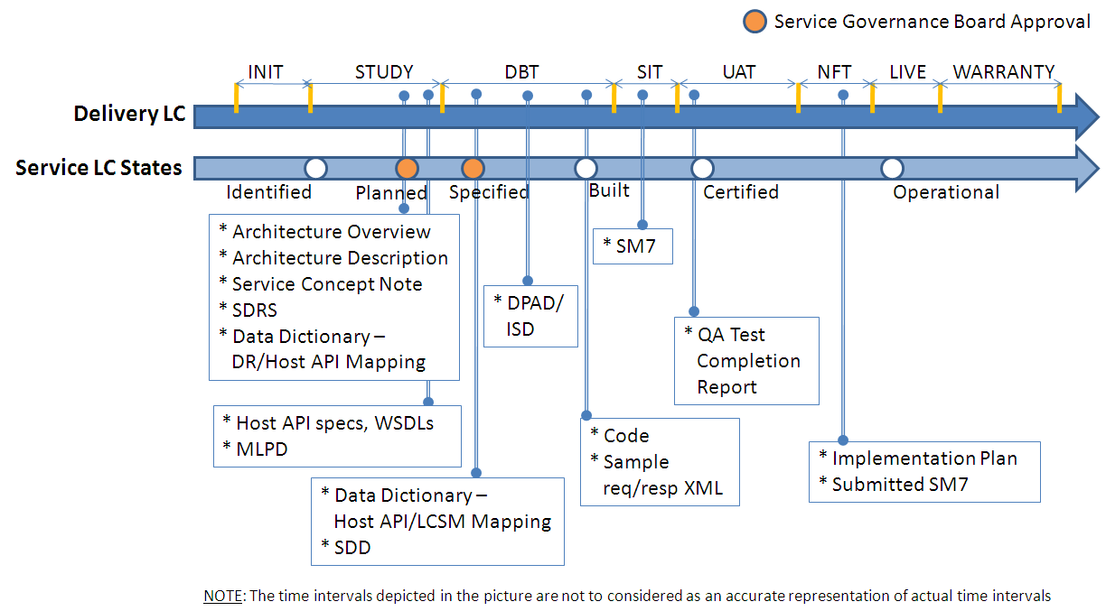
SGB Operating Model – A Lifecycle Guide
Delivery Life Cycle / Service Life Cycle Mapping

Slide 8
Service Governance Board Interlock SGB will operate within the context of various other Governance forums that are exist within Group IT .
Key Principles
Focus of SGB will be limited to the Enterprise Services - their functionality, architecture and design
SGB will interact with and support IT Governance and Architecture Governance functions
The respective Working Group will work on implementation and methodologies. Critical decisions e.g. new patterns discovered during design development will be discussed and ratified at SGB
Broader and strategic initiatives on SOA such as testing strategy, reuse, deployment infrastructure, usage monitoring, model management, architecture changes will be driven by the SOA Steering Group which will work closely with SGB for inputs and validation
New Proposed
See next slide for more...
SOA Steering Group
Architecture Governance Council
(IT Strategy Board)
Consults & informs
Application
Design
Authority
Interlocked governance for
BPM / SOA
Escalates and
reports to SAF
Service Governance Board
SAF
Strategic Architecture Forum
Guides and informs submissions to ADA
Guides and informs submissions to SGB
*Core Working Groups
DAC’s
SOA Surgery / SOA Core Working Group*
EAD
ADM

Slide 9
SOA Steering Committee A brief overview
Overview
SOA Steering Group Responsibilities
Provide the direction for all SOA based initiatives
Act as a final authority for decisions
Attend to decisions for escalated risks & issues
Socialise & champion SOA initiatives within the key enterprise stakeholders and influencers
Identify funding options for the initiatives
Oversee or organise oversight of strategic milestones
SOA Steering Group Membership
Recommended approach to membership of SOA Steering Committee to maximise its effectiveness:
Each stakeholder unit should be represented e.g. Platform, Architecture, Service Delivery, Partner
It should be composed of decision makers of the strategic initiatives from the stakeholder units or their empowered delegates

